Slide 1
Transportation App : GoRoute Presented By, Adith Adithya PK Mahesh Nidugula Alan K Mathew Vendant Zalke

Slide 2
TABLE OF CONTENTS
01
INTRODUCTION
06
HIGH-FIDELITY PROTOTYPE
02
PERSONAS
07
SUMMARY
03
USER STORIES
08
REFERENCES
04
USER FLOW
05
LOW-FIDELITY PROTOTYPE

Slide 3
01. INTRODUCTION
Goroute: Your Urban Mobility Companion. Discover the ease and convenience of public transportation in our city. Seamlessly plan your journeys, access real-time updates, and enjoy hassle-free travel on buses, trains, subways, and trams. Embrace the freedom of exploring the city with GoRoute.
We have local public transportation service, users can book bus, local trains , and we are also providing cab service and ride sharing facility user can choose best of there interest. IT Provide an intuitive journey planner tool that allows users to enter their starting point and destination to find the best routes, schedules, and estimated travel times. Include options for different modes of public transport (bus, train, subway, etc.), as well as any interconnections or transfers required.

Slide 4
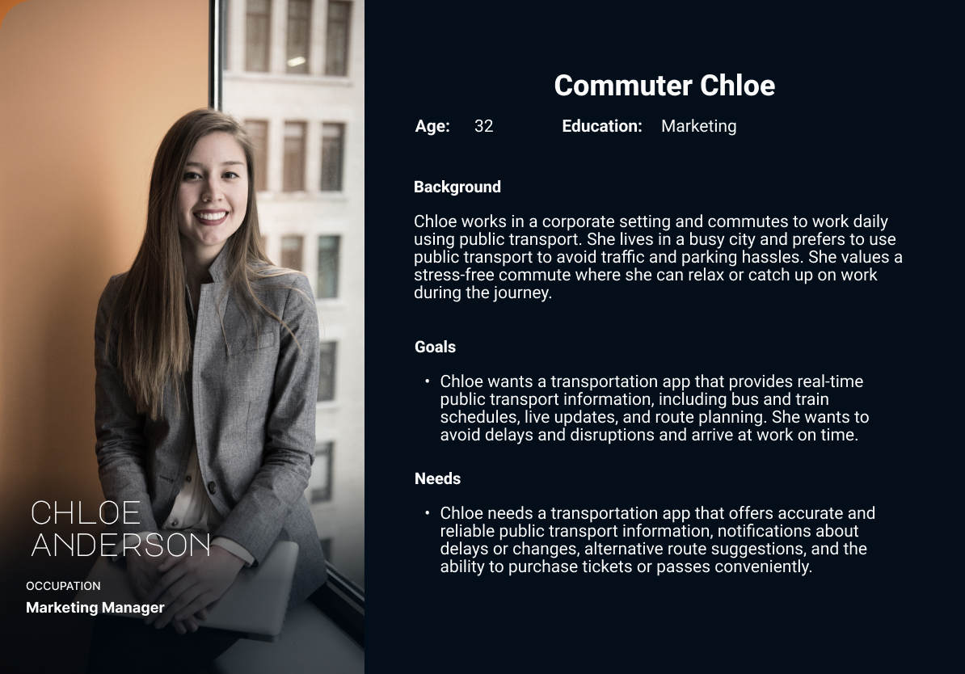
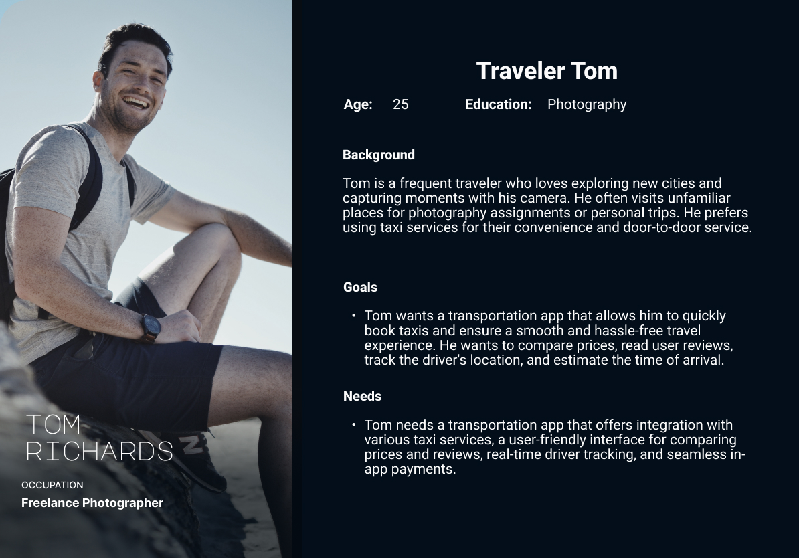
02. PERSONAS

Slide 5
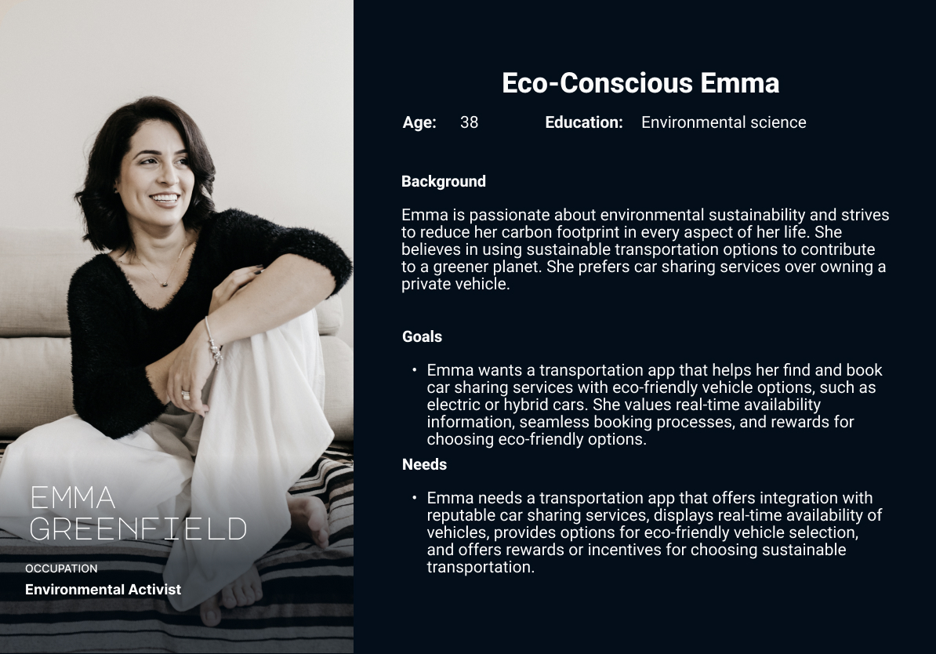
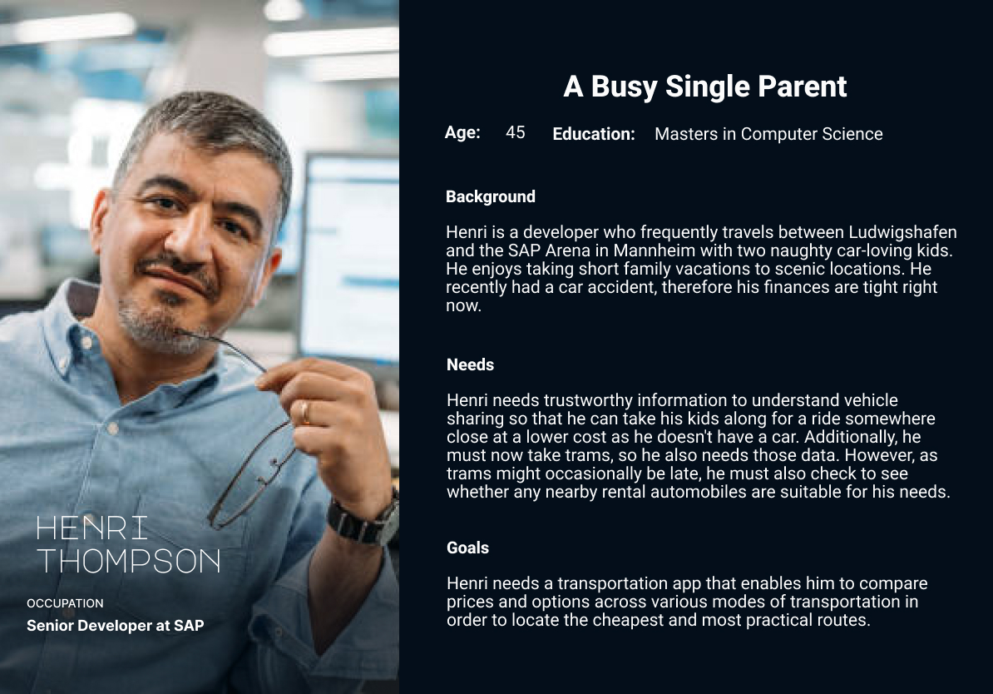
02. PERSONAS

Slide 6
03. USER STORIES
User Story 1:
As Commuter Chloe, I want to view real-time public transport information, including bus and train schedules, live updates, and route planning, so that I can have a stress-free and punctual commute to work.
Acceptance criteria:
The app displays accurate and up-to-date bus and train schedules.
The app provides real-time updates on any delays or disruptions.
The app offers a route planning feature that suggests the most efficient route options based on the user's preferences.

Slide 7
03. USER STORIES
User Story 2:
As Commuter Chloe, I want the transportation app to offer a convenient way to purchase tickets or passes for public transport, so that I can easily manage my fare payments without any hassle.
Acceptance criteria:
The app provides a user-friendly interface to browse and select available ticket options.
Chloe can purchase tickets or passes securely using various payment methods (e.g., credit card).
The app generates digital tickets that can be easily accessed and validated during the commute.

Slide 8
03. USER STORIES
User Story 3:
As Eco-Conscious Emma, I want the transportation app to integrate with reputable car sharing services, display real-time availability of eco-friendly vehicles, and provide a seamless booking process, so that I can choose sustainable transportation options and reduce my carbon footprint.
Acceptance criteria:
The app offers integration with well-known car sharing services that provide eco-friendly vehicle options.
Emma can view real-time availability of eco-friendly vehicles near her location.
The booking process is smooth and straightforward, allowing Emma to reserve a car quickly and easily.

Slide 9
03. USER STORIES
User Story 4:
As Eco-Conscious Emma, I want the transportation app to offer discount by using a discount voucher to further motivate me to make environmentally conscious choices..
Acceptance criteria:
The app implements apply discount voucher system.
The app clearly displays Emma’s discount voucher and their associated benefits.

Slide 10
03. USER STORIES
User Story 5:
As Traveler Tom, I want the transportation app to integrate with various taxi services, allowing me to compare prices, track the driver's location, and estimate the time of arrival, so that I can easily book taxis and have a smooth travel experience.
Acceptance criteria:
The app provides a list of available taxi services along with their respective prices.
The app displays real-time tracking of the assigned driver's location on a map.
Tom can estimate the time of arrival based on the driver's location and the selected route.

Slide 11
03. USER STORIES
User Story 6:
As Traveler Tom, I want the app to support seamless in-app payments for taxi services, eliminating the need for cash transactions and ensuring a convenient and secure payment process.
Acceptance criteria:
The app payment methods, such as credit card, for taxi bookings.
The app displays real-time tracking of the assigned driver's location on a map.
Tom can estimate the time of arrival based on the driver's location and the selected route.

Slide 12
03. USER STORIES
User Story 7:
As Busy Single Parent Henri, I want the transportation app to provide reliable information about vehicle sharing options, including prices and availability, so that I can find affordable transportation solutions for my family trips and daily commuting needs.
Acceptance criteria:
The app displays a comprehensive list of vehicle sharing options, including prices and availability.
The app provides accurate and up-to-date information about vehicle availability.

Slide 13
03. USER STORIES
User Story 8:
As Busy Single Parent Henri, I want the app to display real-time data for trams, allowing me to check their schedules and potential delays, so that I can plan my travels accordingly and avoid any inconveniences.
Acceptance criteria:
The app provides up-to-date tram schedules for Henri's selected routes.
Henri can view real-time information about any delays or disruptions affecting the tram service

Slide 14
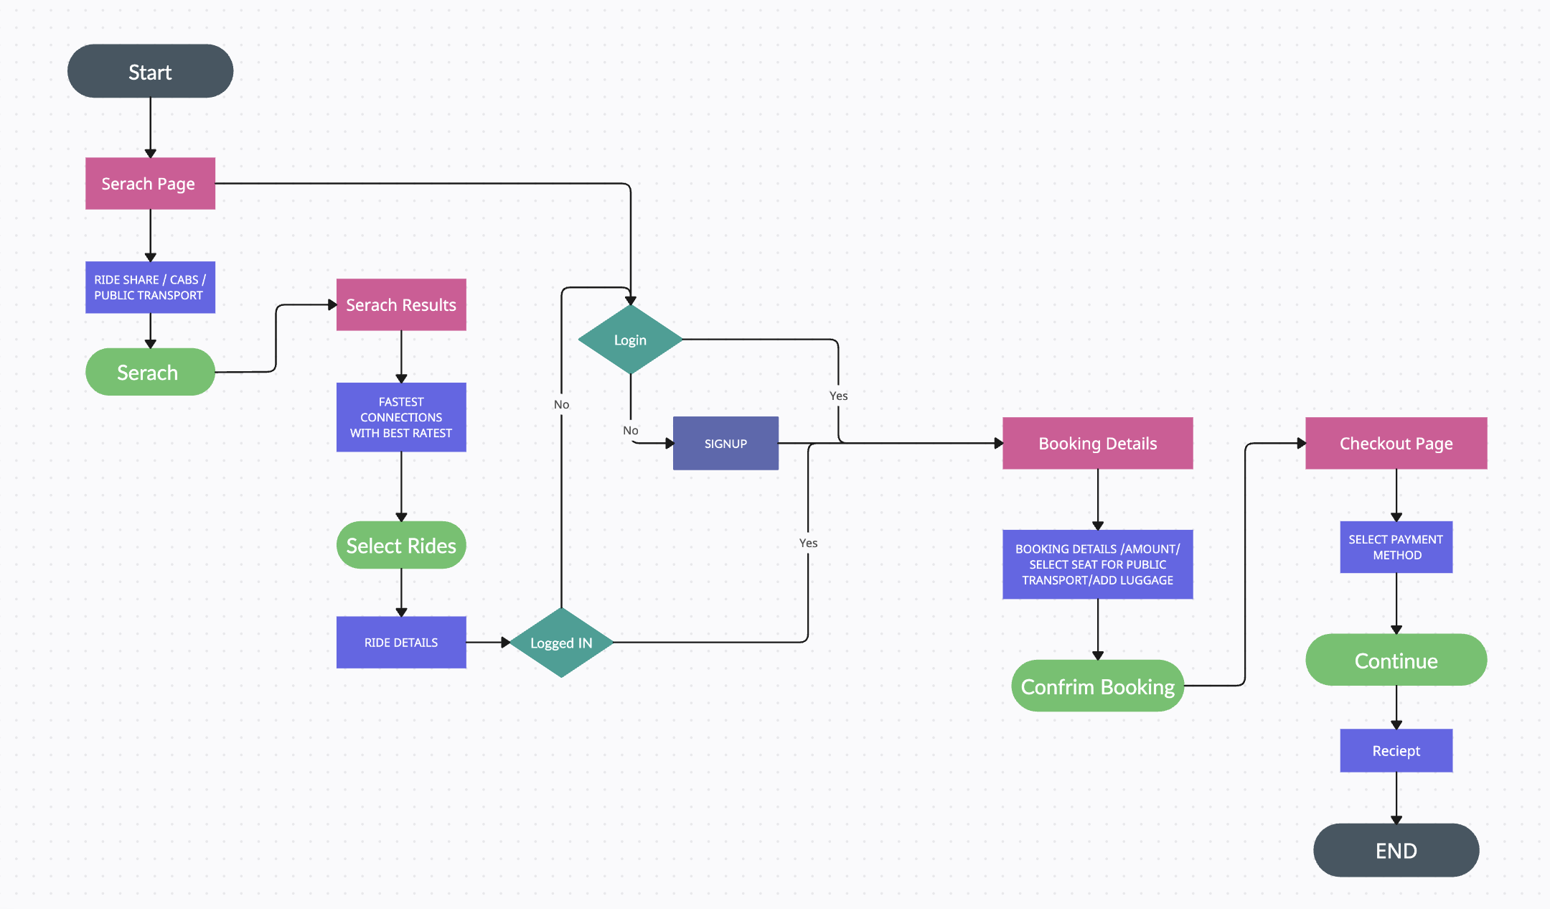
04. USER FLOW
Fig 1. User Flow

Slide 15
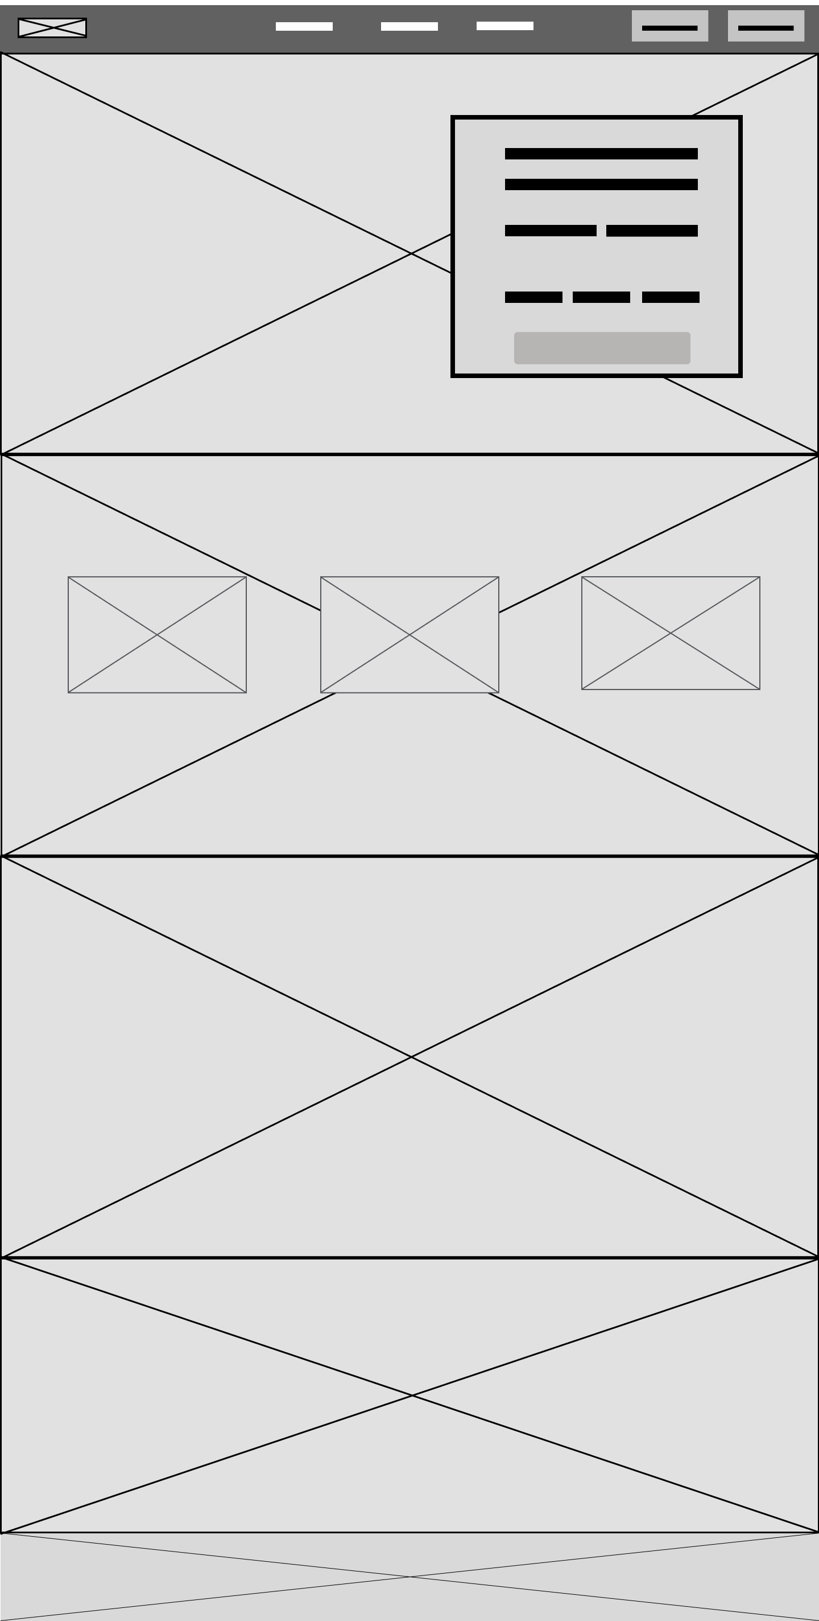
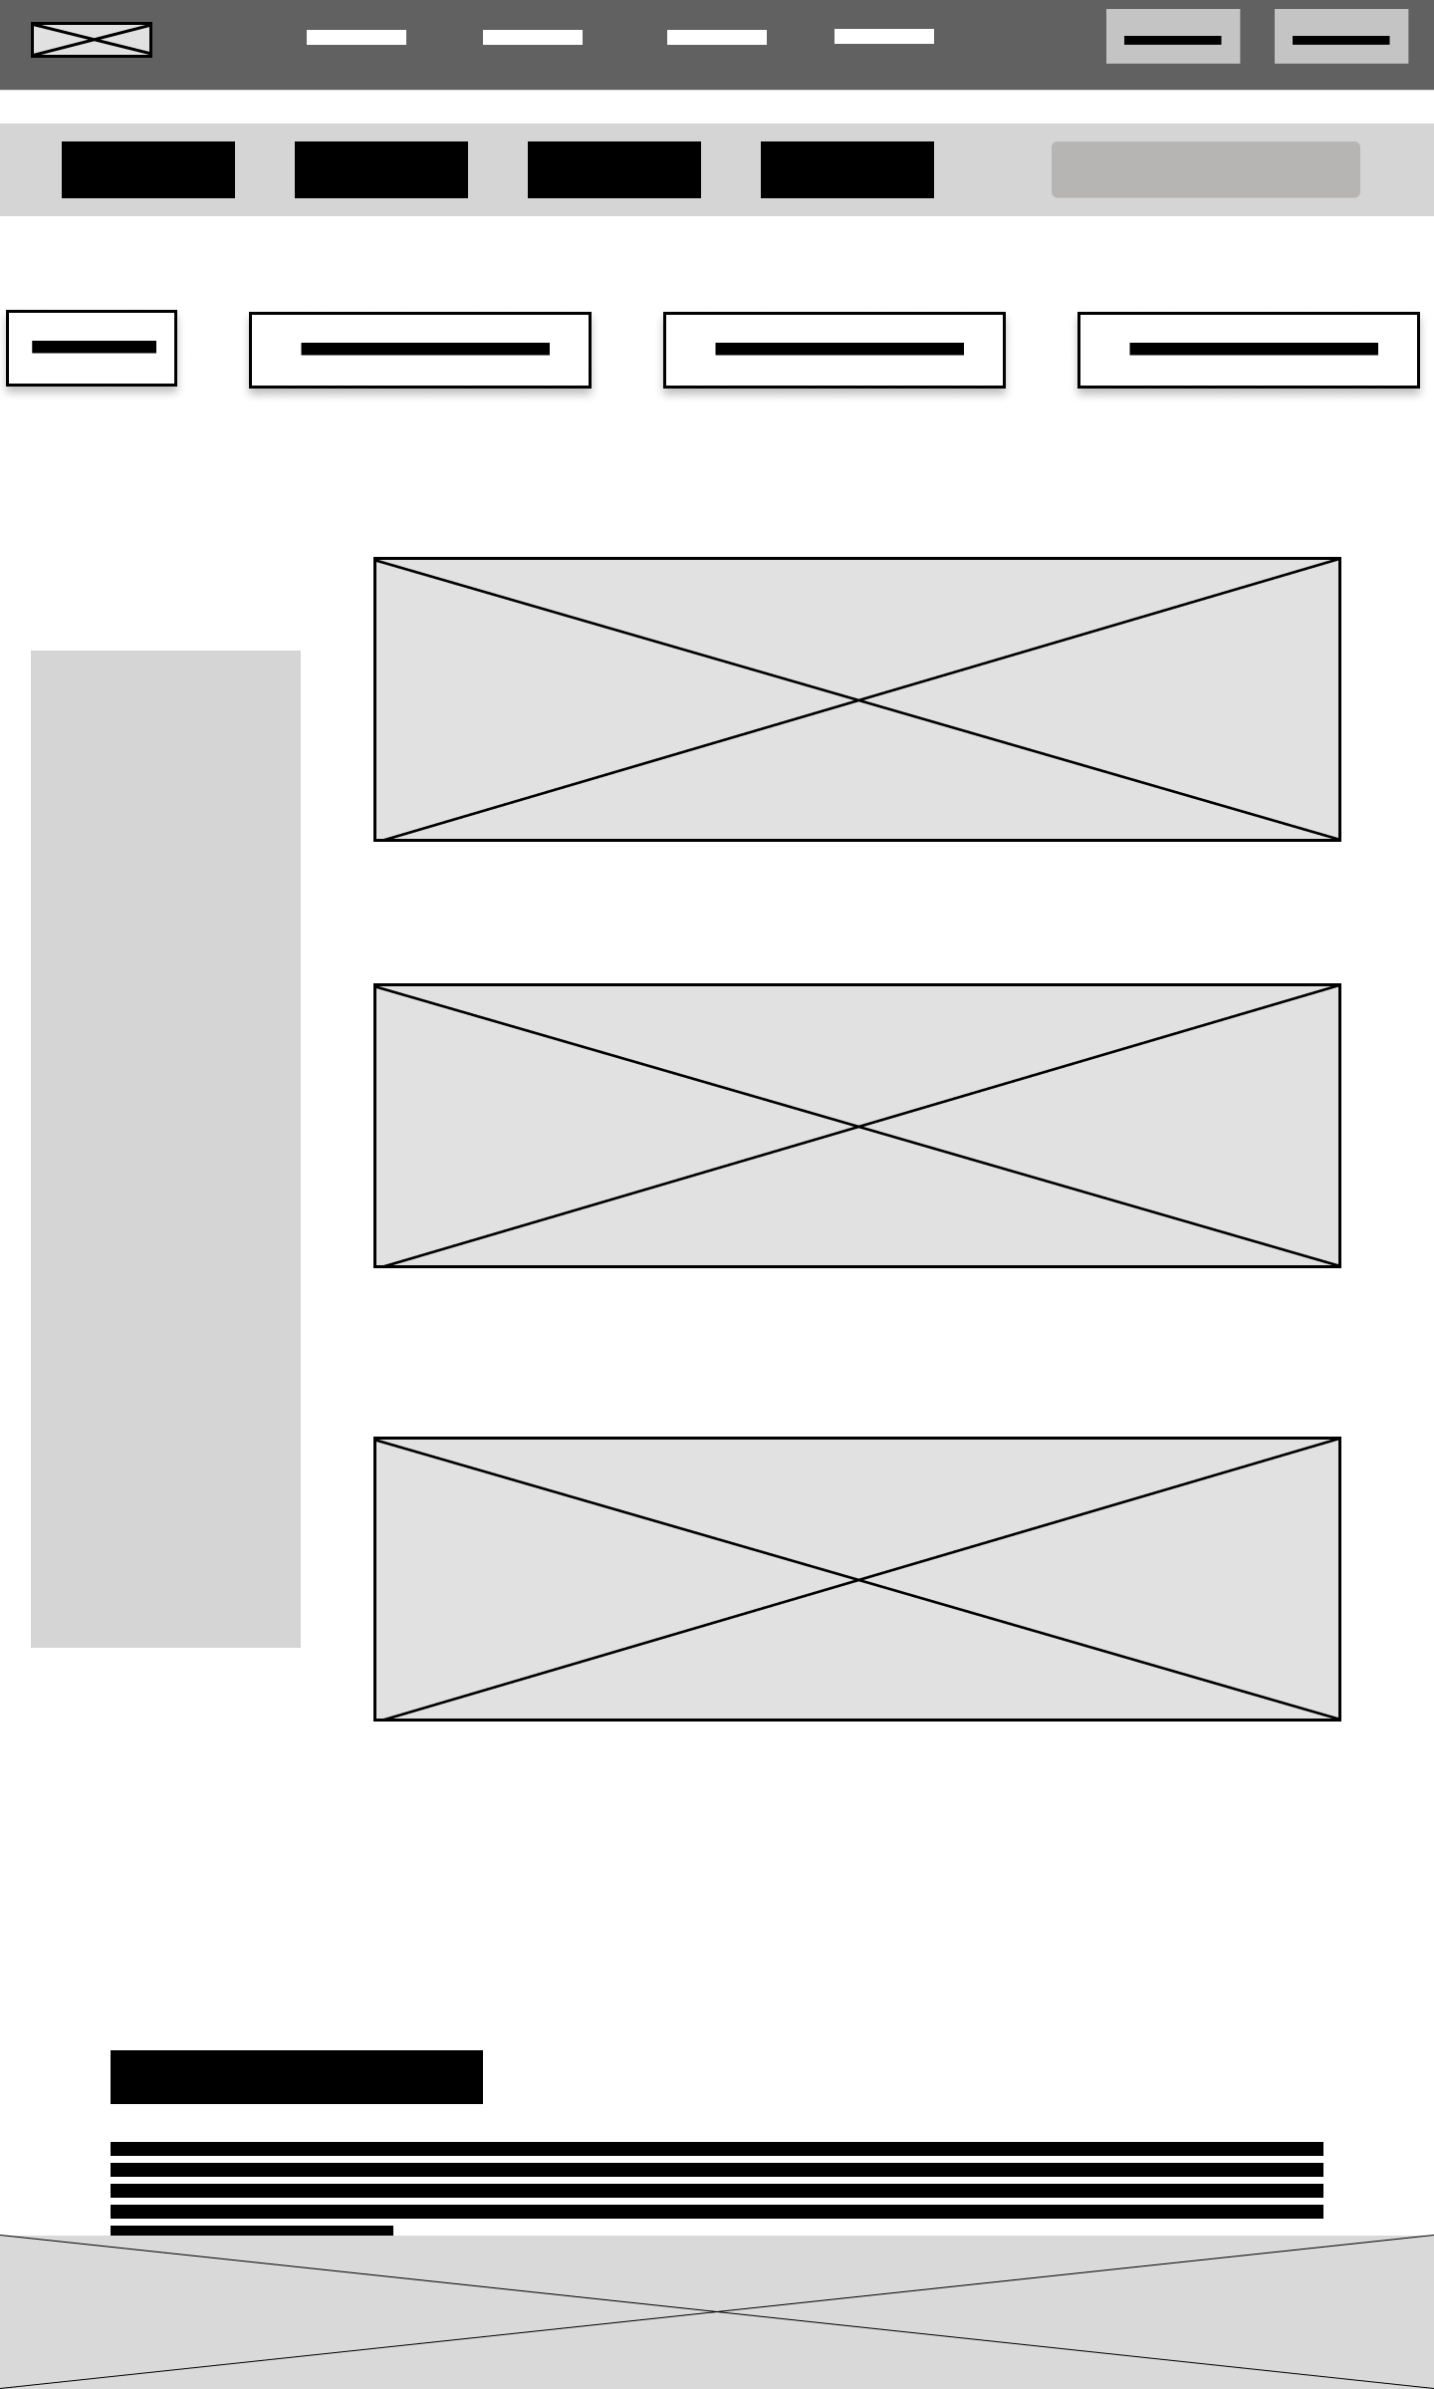
05. LOW-FIDELITY PROTOTYPE
HOME
SERVICE
Fig 2. Home Page
Fig 3. Service Page

Slide 16
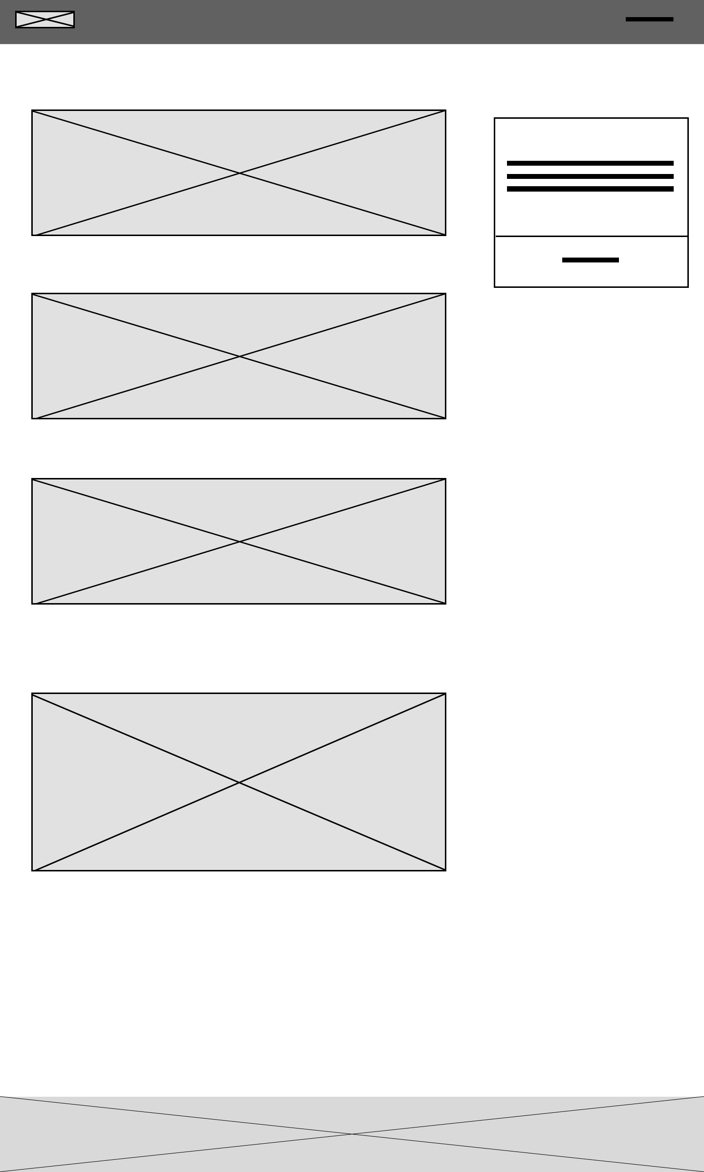
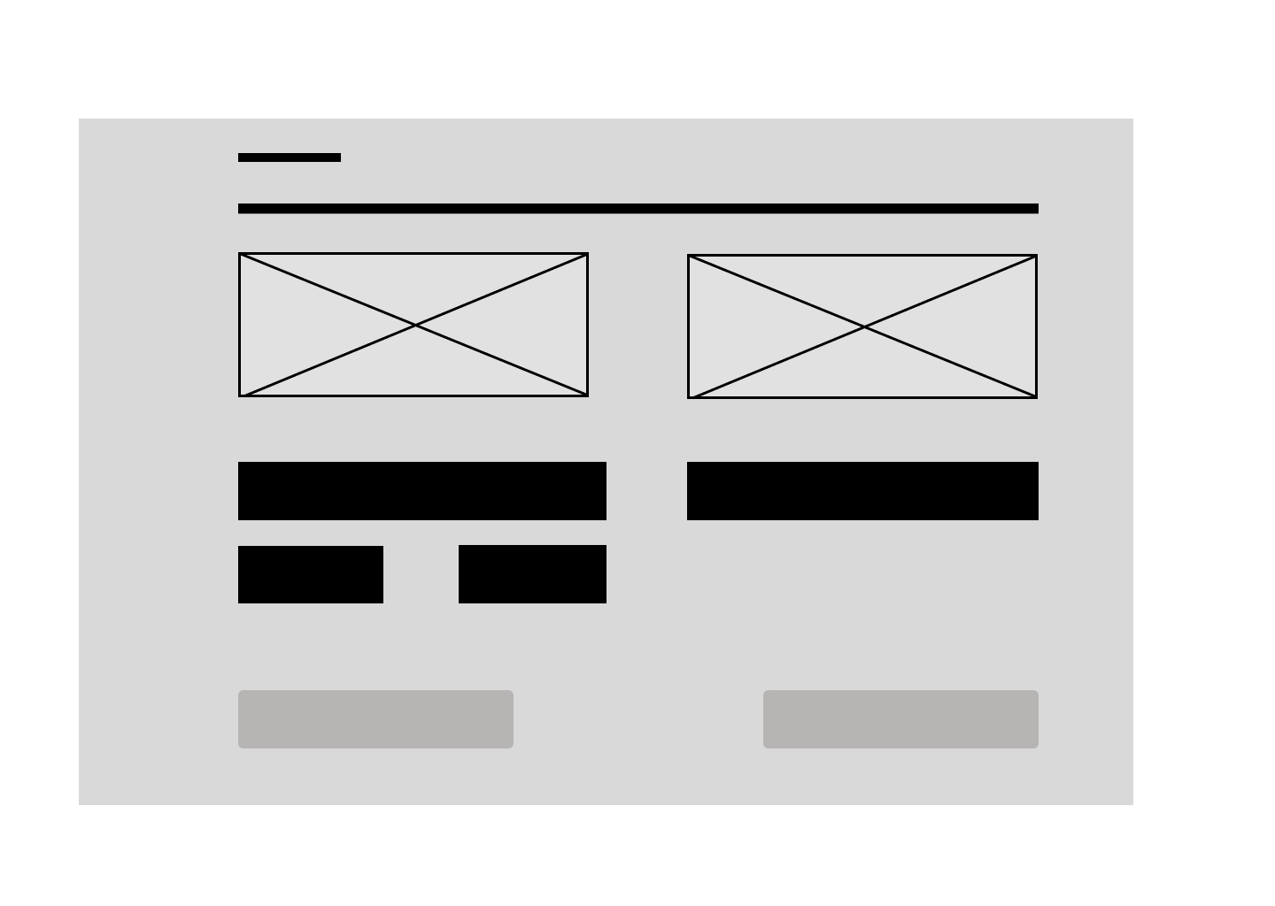
05. LOW-FIDELITY WIREFRAME
DETAILS
CHECKOUT
Fig 4. Booking Details Page
Fig 5. Checkout Page
https://www.figma.com/file/rvneLAcB6GbmIGaZB09OfZ/lofi-wireframe?type=design&node-id=0%3A1&mode=design&t=n9CyMd56fpbme48N-1

Slide 17
06. HIGH-FIDELITY WIREFRAME
https://www.figma.com/file/FMaaHTKJrPF5HJeLqCrZFC/Adith?type=design&node-id=0%3A1&mode=design&t=Cb8TiYA342rThiI8-1

Slide 18
07. SUMMARY
GoRoute is an urban mobility web app that simplifies public transportation by providing users with an intuitive journey planner tool, real-time updates, and various transportation options. Users can effortlessly plan their journeys, access accurate schedules, and estimated travel times for buses, local trains, subways, and trams. Additionally, the app offers the convenience of booking cabs and utilizing ride-sharing services, allowing users to choose the mode of transportation that best suits their needs. With GoRoute, users can explore the city with ease and enjoy a hassle-free travel experience.

Slide 19
08. REFERENCES
https://www.flix.com/
https://www.uber.com/us/en/ride/
https://www.blablacar.co.uk/
https://www.omio.com/
https://www.freepik.com/free-vector/shuttle-bus-isometric-landing-page_13277008.htm#query=bus%20transportation%20hero%20image&position=1&from_view=search&track=ais
https://www.w3schools.com/html/default.asp
https://legacy.reactjs.org/

Slide 20
Thankyou for your attention!

